Slide 1
Columns and Bars
Columns and Bars

Slide 2
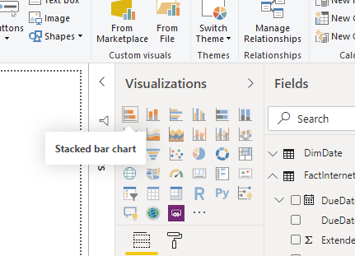

Columns and Bars
Note: This exercise requires the AdventureWorks2016 database
Import the DimDate and FactInternetSales tables from the AdventureWorks2016 database
In the Visualizations area , try hovering over the first 5 items

Slide 3
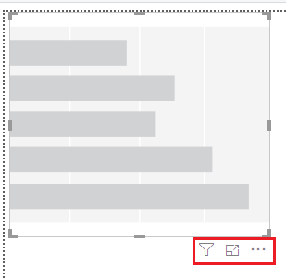

Columns and Bars
Add the Stacked bar chart visualization to the scene and try to discover the icons located just at the bottom right
There is the filter feature , the focus feature and the spot light feature.

Slide 4
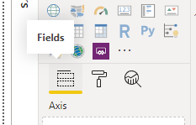
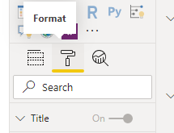
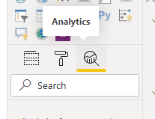
Columns and Bars
Notice the following three sections just below the Visualizations section at the bottom

Slide 5
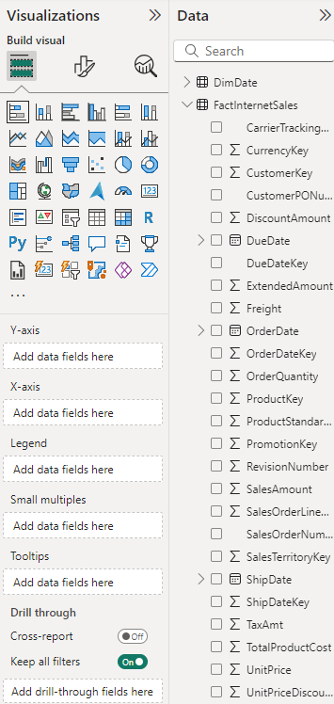
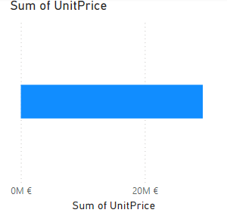
Columns and Bars
UnitPrice field from the Fields section from the FactInterntSales table to the X-Axis

Slide 6
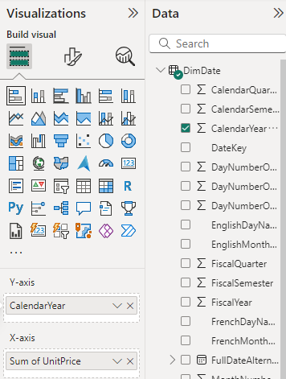
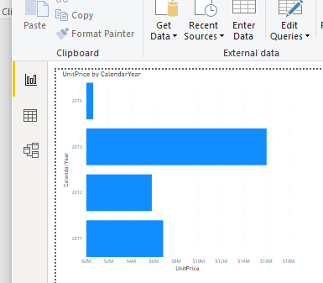
Columns and Bars
Drag the CalendarYear from DimDate in the Y-Axis level field from the DimDate table

Slide 7
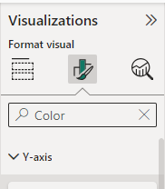
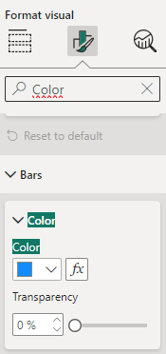
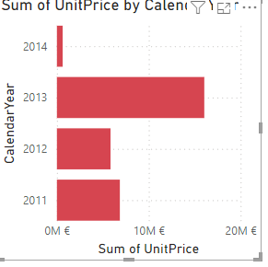
Columns and Bars
Type Color in the search bar in the Format section
Try changing the Bars color to Red
Type Text and try to change text characteristics

Slide 8
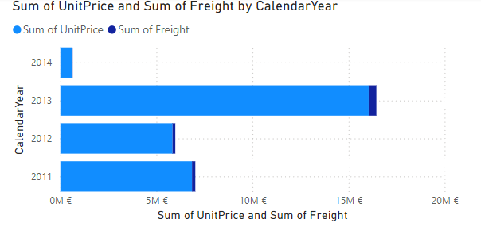
Columns and Bars
Expand the visualization
Add Freight field to the X-Axis parameter
Notice that the visualization changes

Slide 9
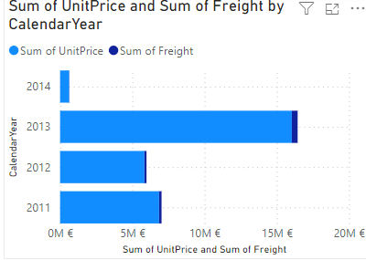
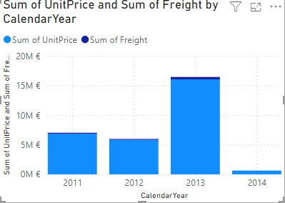
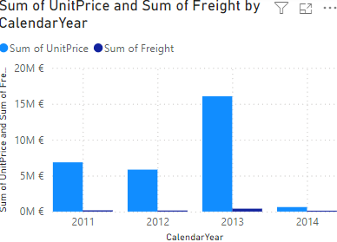
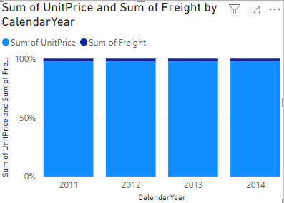
Columns and Bars
Select the visualization and try changing the visualization type by selecting each time a column or bar visualization type
Delete the Freight field and and add EnglishMonthName to the legend
Select the Analytics area and then add a constant line

Slide 10
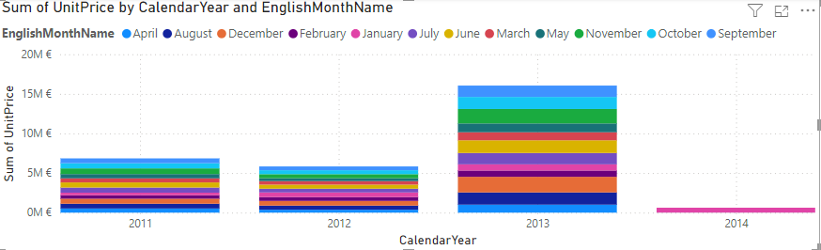
Columns and Bars
Select the visualization and try changing the visualization type by selecting each time a column or bar visualization type
Delete the Freight field and and add EnglishMonthName to the legend

Slide 11
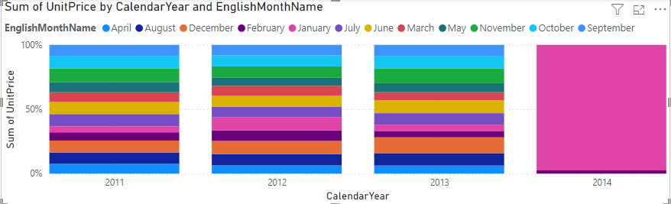
Columns and Bars
Change the visual type to 100% Stacked Column Type

Slide 12
Thank you
Thank you

